Slide 1
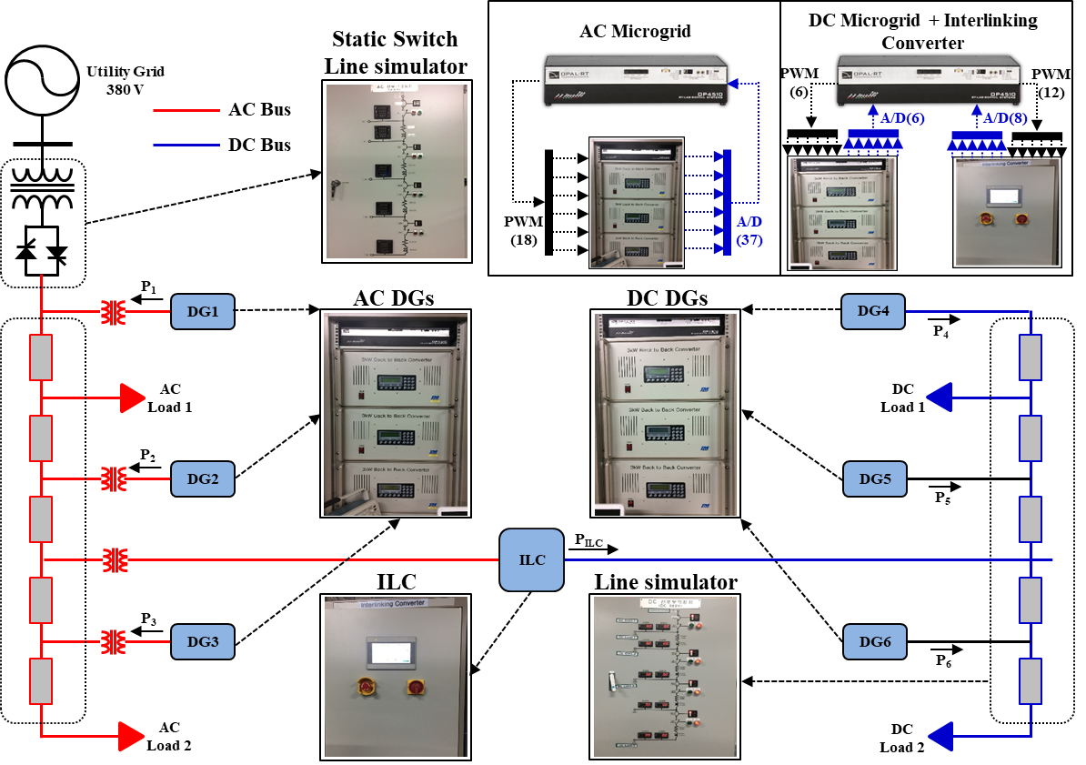
Korea Electrotechnology Research Institute (KERI) control and analyze grid-connected power conversion system
Challenge
Conduct a preliminary review and develop solutions for concerns that problems may arise in terms of economics, time, and efficiency regarding the connection to the power grid with large-scale wind power plants
Solution
Use Simscape Electrical to develop a hybrid model capable of Phasor and EMT simulation for large-scale power system simulation and establish a HILS environment using the model.
Results
Evaluate performance through development of RCP, CHIL, and PHIL for power system
Increase simulation speed to be able to build HILS through hybrid simulation
“We built a real-time simulation environment for smart distributed distribution system development and technical and economic evaluation. We were able to perform large-scale power system analysis through hybrid simulation with MATLAB/Simulink.” - Hyeong-Jun Yoo, KERI
Notes:
Industries: Consumer Electronics
Application Areas: Embedded Systems, Signal Processing
Capabilities: Algorithm Development, Data Analysis, Embedded Code Generation
Products Used: MATLAB, Embedded Coder, MATLAB Coder, Parallel Computing Toolbox, Signal Processing Toolbox, Statistics and Machine Learning Toolbox
Country: United States

